Slide 1
Applied Data Science with R Capstone Project: Seoul Bike Sharing Demand Prediction
Rajdeep Sandhu
15 September 2023

Slide 2

Outline
Executive Summary
Introduction
Methodology
Results
Conclusion
Appendix

Slide 3

Executive Summary
In Seoul, a total of 20,000 bikes serve a population of almost 21.8 million.
Bike sharing demand
Highest in the evenings, followed by mornings, possibly due to commuting
Highest in summer.
Spikes in June and September, possibly due to vacations and tourism
Low with high humidity.
A small proportion of bikes is in use with occasional spikes.
Important predictors
Rainfall, humidity and temperature.
Season and hour.
Higher order polynomial regression performs the best for demand prediction.

Slide 4

Introduction
Background
Several bike sharing schemes worldwide
Optimal, accessible and reliable supply needed at all times.
Cost minimization by minimizing supply to meet demand
Aim: Weather data analysis to predict Bike Sharing demand
To predict the number of bikes required each hour of the day
Based on current conditions such as the weather

Slide 5

Methodology
Perform data collection
Perform data wrangling
Perform exploratory data analysis (EDA) using SQL and visualization
Perform predictive analysis using regression models
How to build the baseline model
How to improve the baseline model
Build a R Shiny dashboard app

Slide 6

Methodology

Slide 7
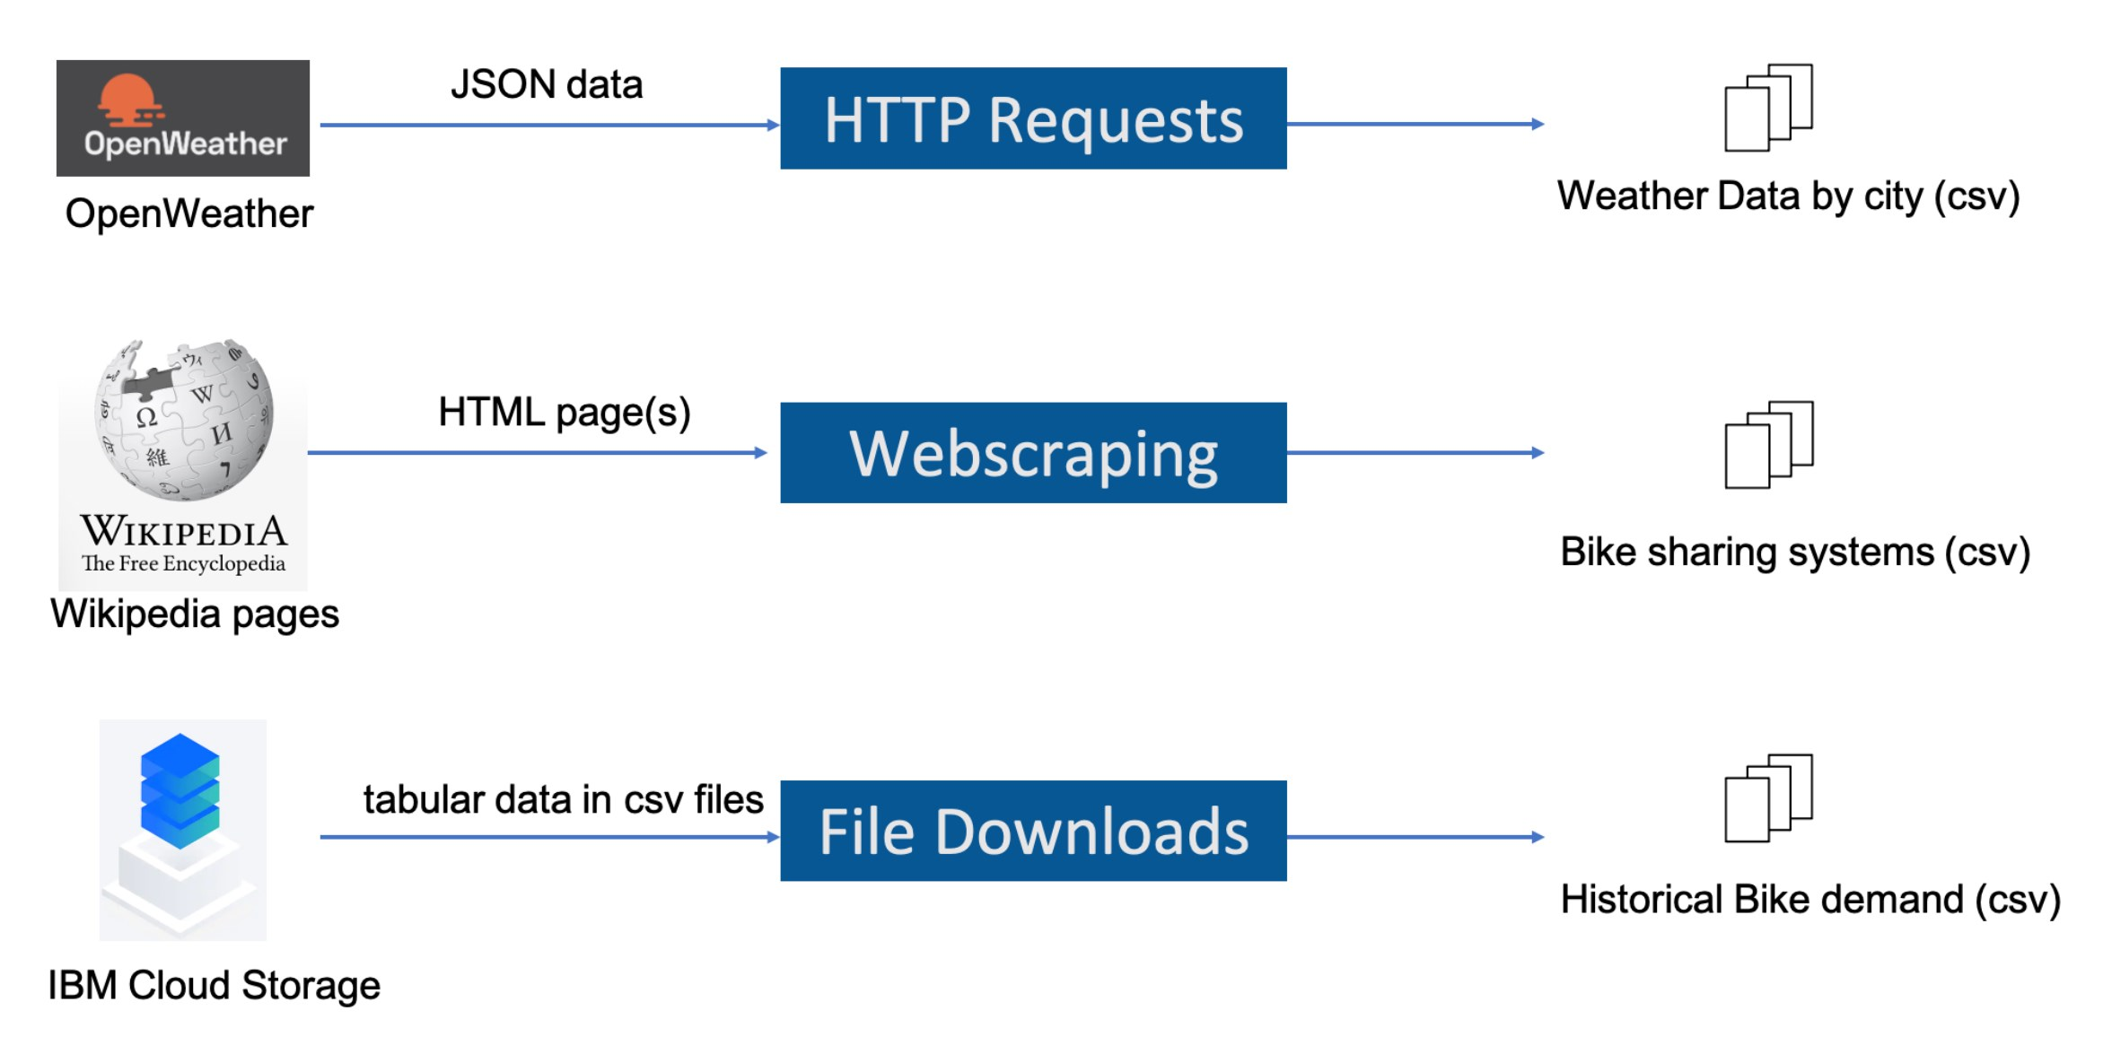
Data collection
Current and forecasted OpenWeather Data using REST API to csv.
Wikipedia Bike Sharing Systems Page webscraped for worldwide bike sharing systems data to csv
https://en.wikipedia.org/wiki/List_of_bicycle-sharing_systems
Aggregated data (.csv) downloaded from IBM Cloud Storage
Seoul Bike Sharing Demand Data Set
Weather and bikes rentals per hour and date
The Global Bike Sharing Cities Dataset
World Cities Data
Geolocation data for major cities worldwide
Credit: IBM Data Analysis for R Course

Slide 8
Data Preprocessing
Scraped Bike Sharing Systems Data (JSON)
Web-scraped Wikipedia Bike Sharing Systems data
Dataframe from JSON
Regex and dplyr
To remove extraneous text, characters, links, inconsistent formatting
Extract numerics
Missing values handled
Categorical variables converted into indicator variables
Normalisation applied
Convert to Dataframe
Regex and dplyr to clean and extract numerics
Drop and impute missing values
One hot encode categoricals to dummy variables
Normalise
Standardise column names
Save to csv

Slide 9
Data Preprocessing
Seoul bike sharing historical demand dataset
Using Tidyverse
Missing values dropped from RENTED_BIKE_COUNT
As these are a small proportion of dataset
This cannot have missing values as a response variable
Average imputed for summer TEMPERATURE
Important predictor variable.
SEASONS, HOLIDAY, and HOUR converted into dummy (indicator) variables (one hot encoding)
FUNCTIONING_DAY has not converted (as no categorical data)
min-max normalization applied to numerical columns
Column names standardised for all datasets
All data written to CSV

Slide 10
EDA with SQL
The following SQL queries were performed
Number of records in the seoul_bike_sharing dataset
Number of hours with non-zero rented bike count.
Weather forecast for Seoul over the next 3 hours.
Seasons included in the seoul_bike_sharing dataset.
First and last dates in the seoul_bike_sharing dataset.
Busiest bike rental times
Hourly popularity and temperature by seasons
Rental Seasonality
Weather Seasonality
Bike-sharing (Total bike count and city) info for Seoul
Cities comparable to Seoul’s bike sharing system

Slide 11
EDA with data visualization
The following charts were plotted
Scatterplot of Bike rental vs. Date
Scatterplot of Bike rental vs. Datetime
Bike rental histogram and kernel density
Scatterplot of Bike rental vs. Temperature faceted by Season
Boxplot of Bike Rental vs Hour faceted by Season
Daily total rainfall and snowfall (bar chart)
Bike rental per hour faceted by Season (boxplot)

Slide 12
Predictive analysis (Model Development)
RENTED_BIKE_COUNT is the response (target) variable
Predictors include
Weather features (temperature, wind speed, rainfall/snowfall)
Date/time features (hour, day of week, month, vacation)
The dataset was split into testing and training sets
A linear regression model was built using only weather features
A linear regression model was built using all features
Features with large coefficients were identified.
Predictions were made using each model.
The models were evaluated using R-squared and RMSE.
Train-test split
Model development
Prediction
Model refinement
Model Evaluation
Model Selection

Slide 13
Predictive analysis (Model Refinement)
Further models were built
Addition of higher order polynomial terms to the linear regression model
Interaction terms were added to the polynomial regression model
Regularisation terms were added using a glmnet linear regression model
5 models were built in total
Predictions were made with each model.
The models were evaluated using R-squared and RMSE.

Slide 14
Build a R Shiny dashboard
Leaflet-based interactive map
Shows the maximum predicted bike-sharing demand in the next 5 days based on a regression model using OpenWeather forecast data
An overview map displays basic bike prediction
A dropdown allows selection of a specific city (New York, USA, Paris, France, Suzhou, London)
Detailed bike-sharing demand plots for a user selected city
ggplot renders on drilling down to a city
Interactive bike-sharing prediction trend
Static temperature trend line for the next 5 days
Humidity
Static humidity and bike-sharing demand prediction correlation plot

Slide 15
Results
Exploratory data analysis results
See individual slides
Predictive analysis results
The Polynomial Regression model with added terms was found to be the best performing.
See dashboard slides for screenshots

Slide 16
EDA with SQL

Slide 17
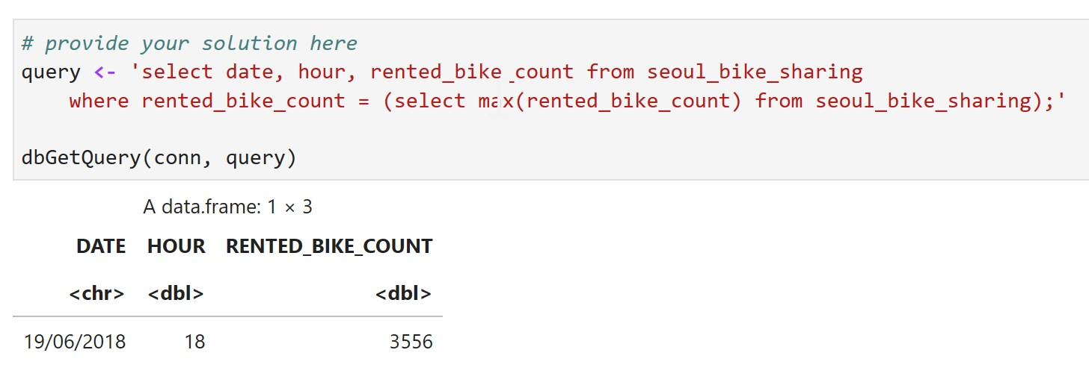
Busiest bike rental times
The maximum rental count and the associated date and hour indicate that the busiest period was 1800h on 19th June 2018.

Slide 18
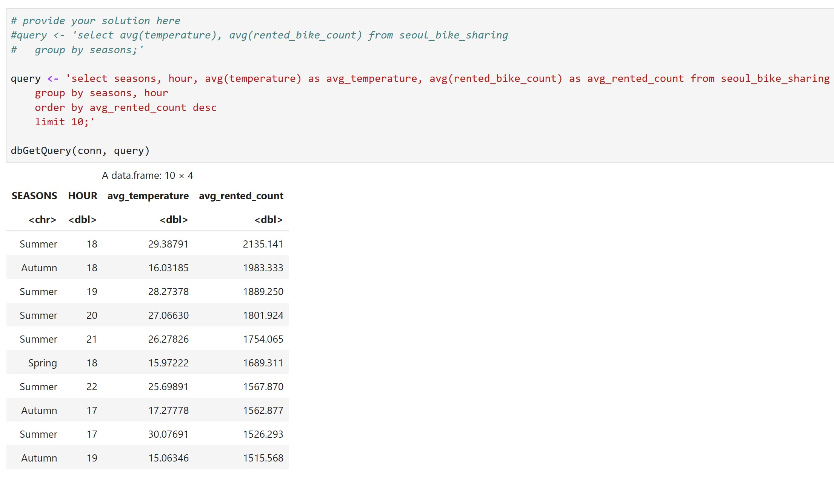
Hourly popularity and temperature by seasons
The top 10 average rental counts alongwith the associated average temperature, grouped by season and hour indicate that evenings in summer and autumn are most popular.

Slide 19
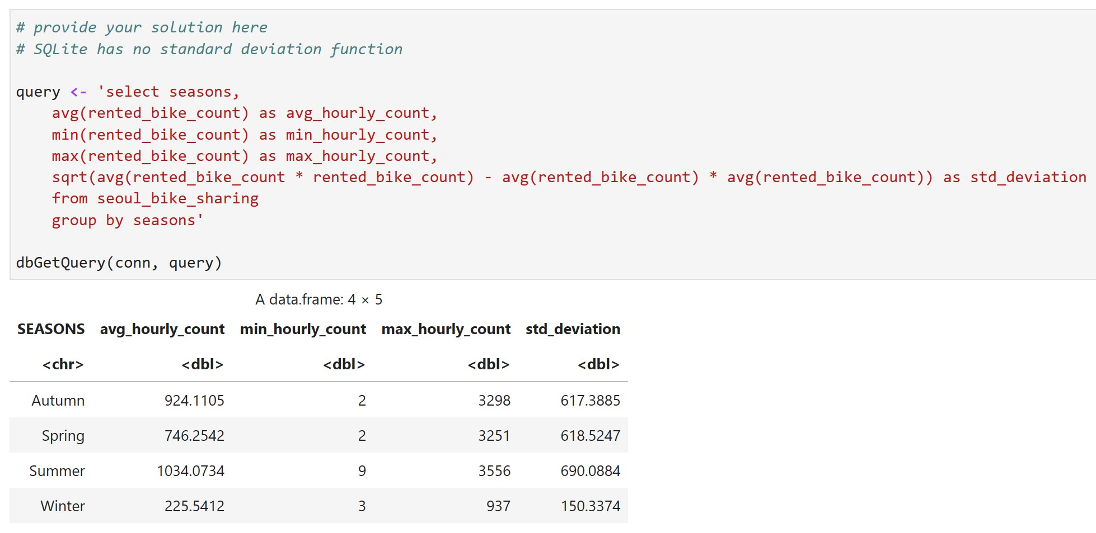
Rental Seasonality
Summer is the most popular, followed closely by autumn and spring.
Rentals drop sharply in winter, with a much smaller standard deviation.

Slide 20
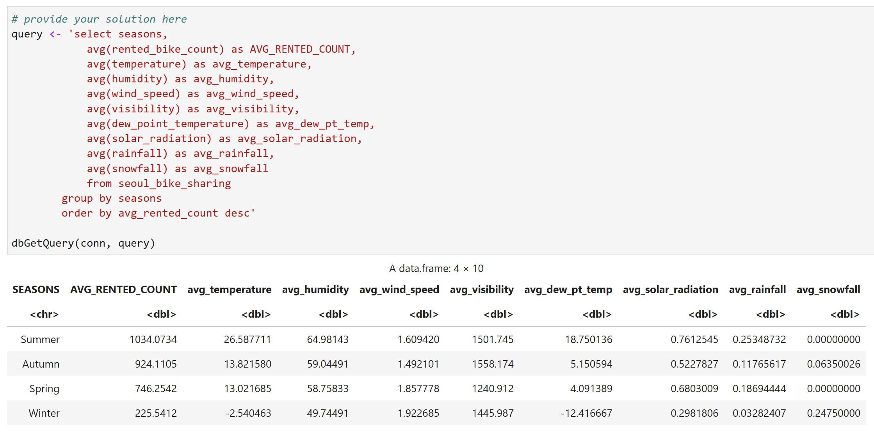
Weather Seasonality
A similar pattern is evident of summer being the most popular, with rentals reducing during autumn and spring and falling sharply during winter.
There seems to be a correlation with temperature, visibility, sunlight and snowfall, which needs further exploration.

Slide 21
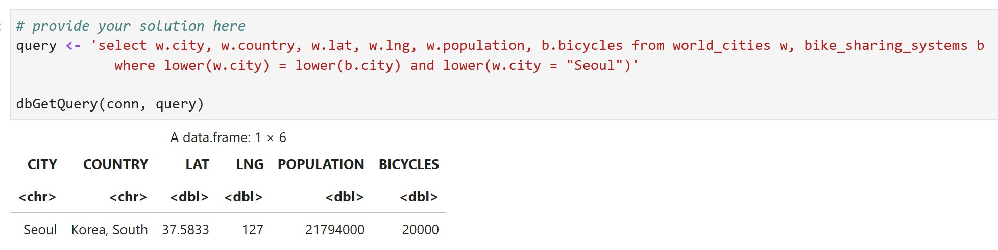
Bike-sharing info in Seoul
A total of 20,000 bikes serve a population of almost 21.8 million.

Slide 22
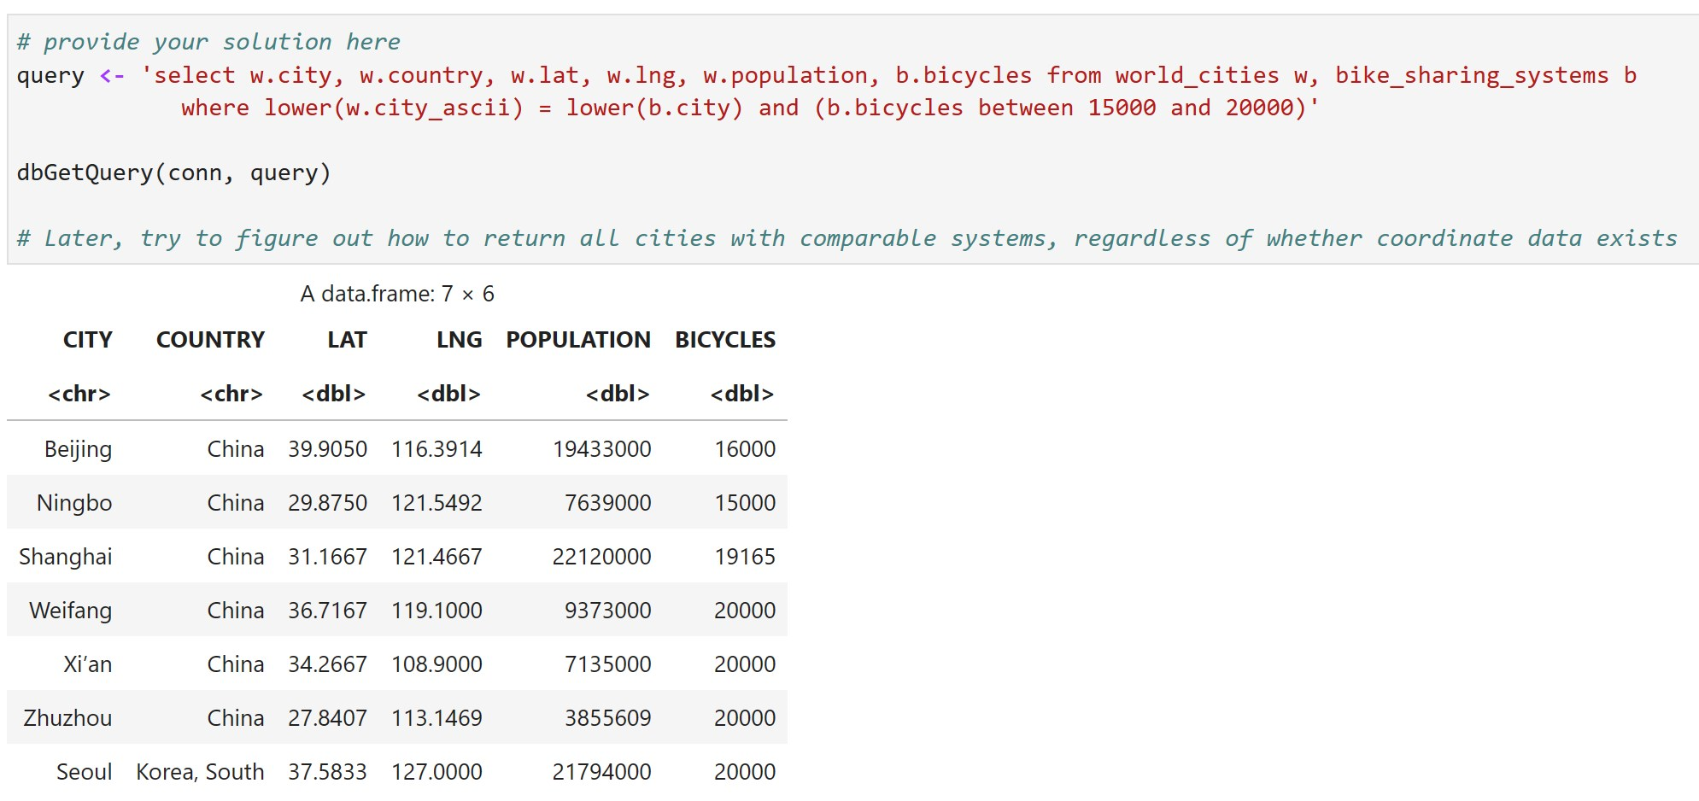
Cities similar to Seoul
Interestingly, all other cities with comparable bike share systems are based in China.

Slide 23
EDA with Visualization

Slide 24
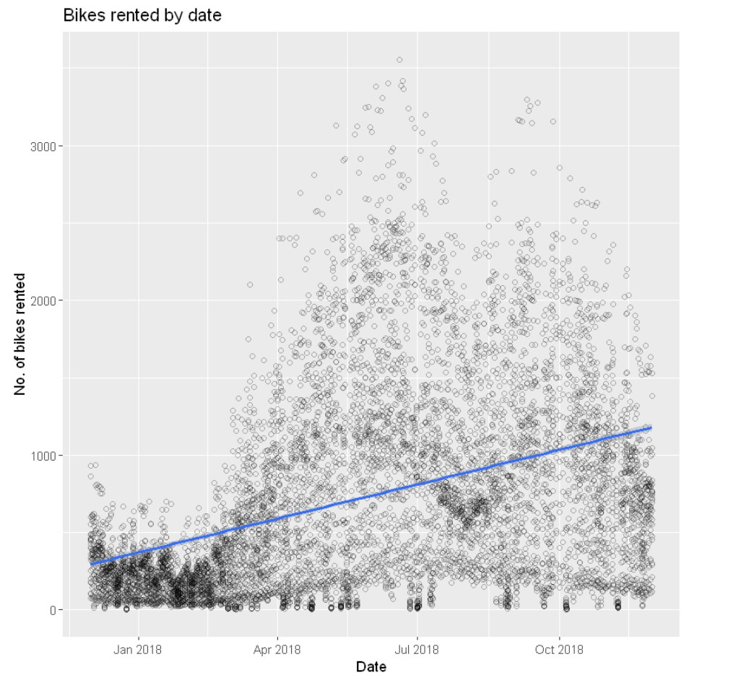
Bike rental vs. Date
Without the benefit of prior or subsequent data, a scatterplot of bikes rented by date reveals:
Demand is lowest earlier in the year and increases gradually, as illustrated by a linear regression line.
There are two spikes, one around June and another around September, which could be accounted for by holidays and tourism.
Demand reduces closer to December and seems to be minimum during January and February, possibly due to cold weather and a preference for other modes of transport.

Slide 25
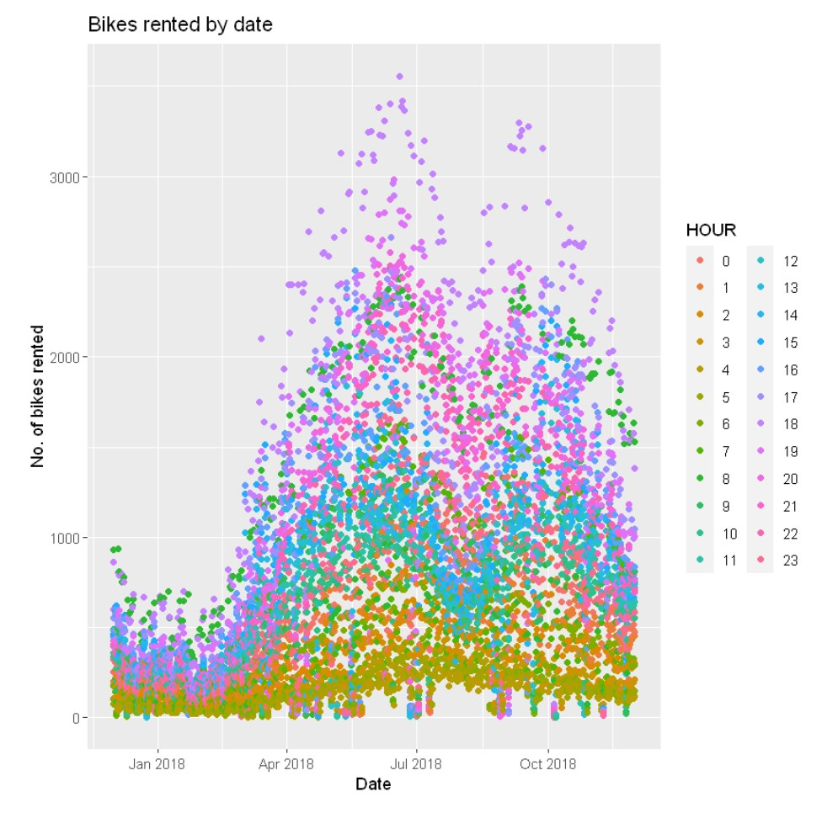
Bike rental vs. Datetime
The same scatterplot, colour coded by hour.
The increase in demand during the spikes seems to have a big contribution from the evenings, especially around 1800h to 1900h, with another slightly smaller contribution around 0600h to 0800h.
These might be due to commuting hours.

Slide 26
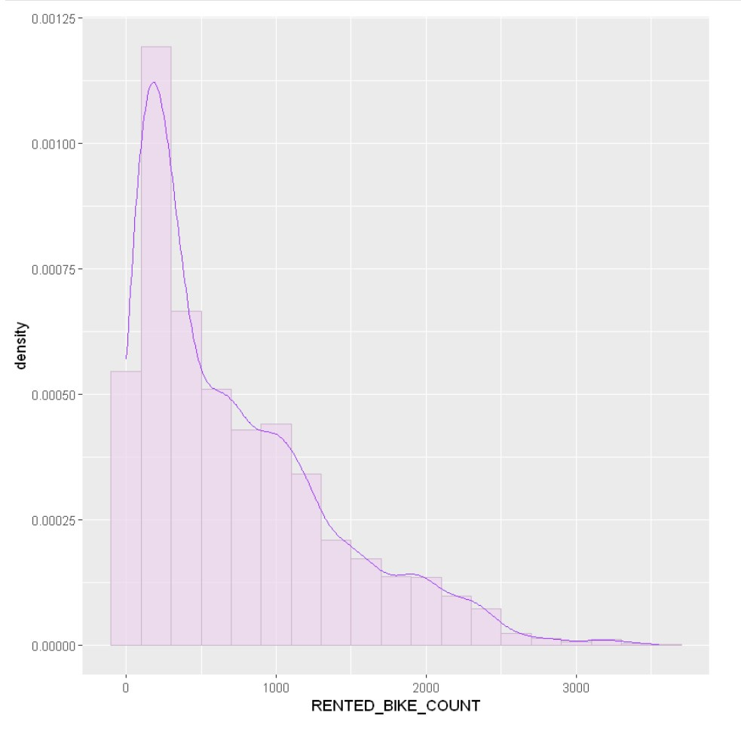
Bike rental histogram
Histogram of bike rentals with a kernel density curve
Only a few bikes are rented most of the time.
The mode is between 200 and 300.
On occasion, a high number of bikes gets rented.
This might have implications on supply meeting demand.

Slide 27
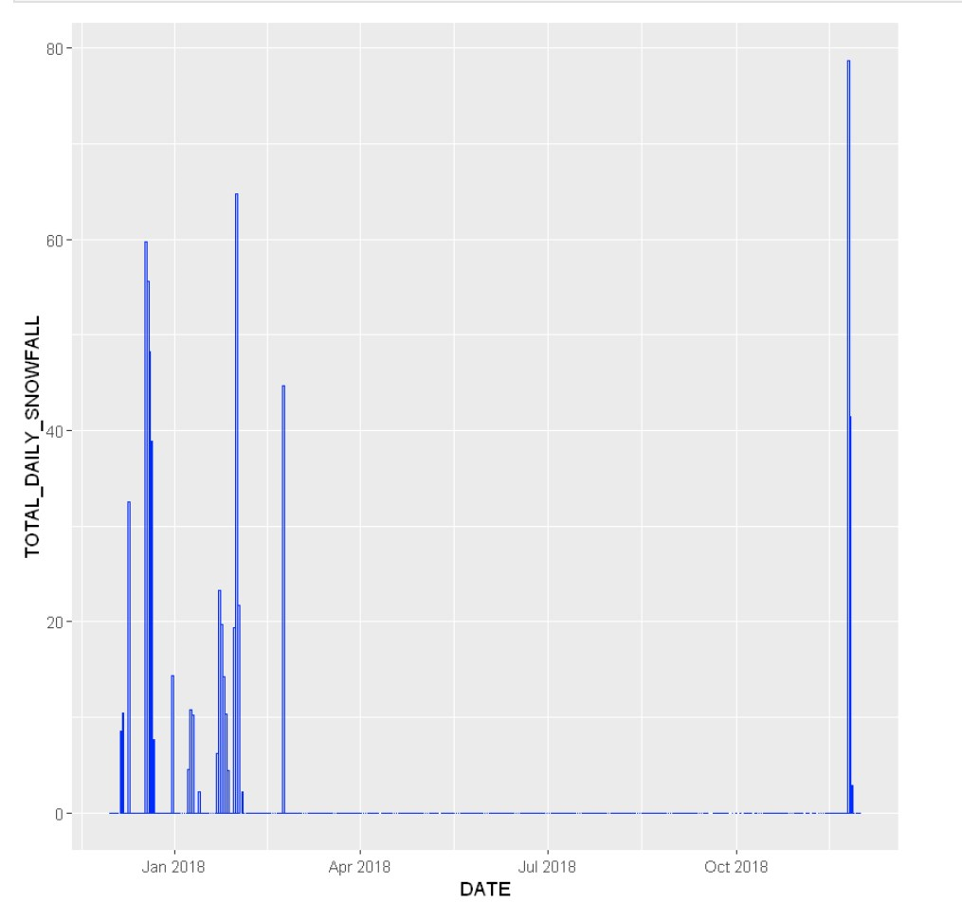
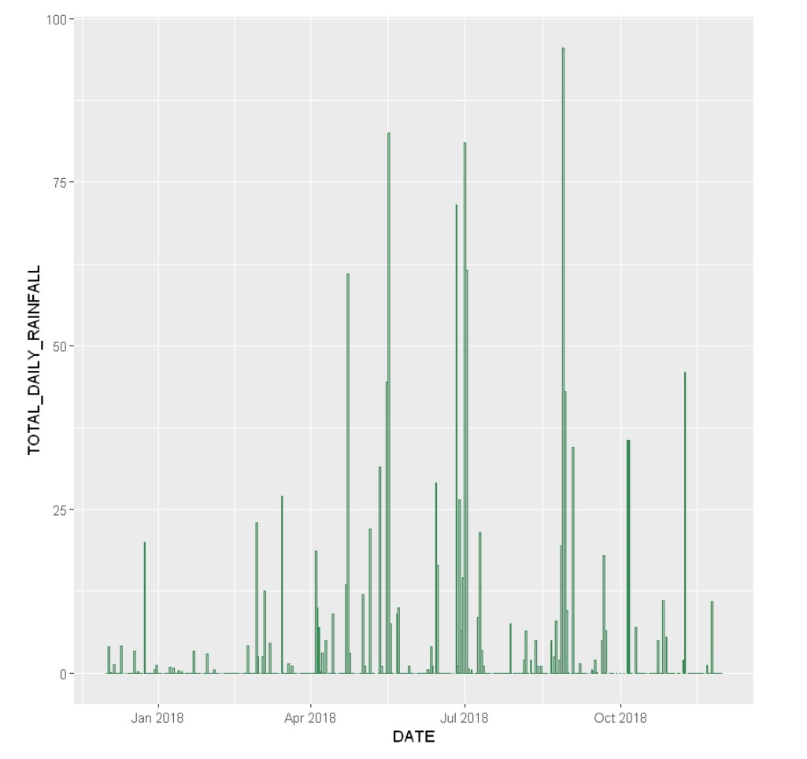
Daily total rainfall and snowfall
A total daily snowfall bar chart reveals concentration in the winter months.
A similar chart for rainfall reveals spikes around May, July and September.

Slide 28
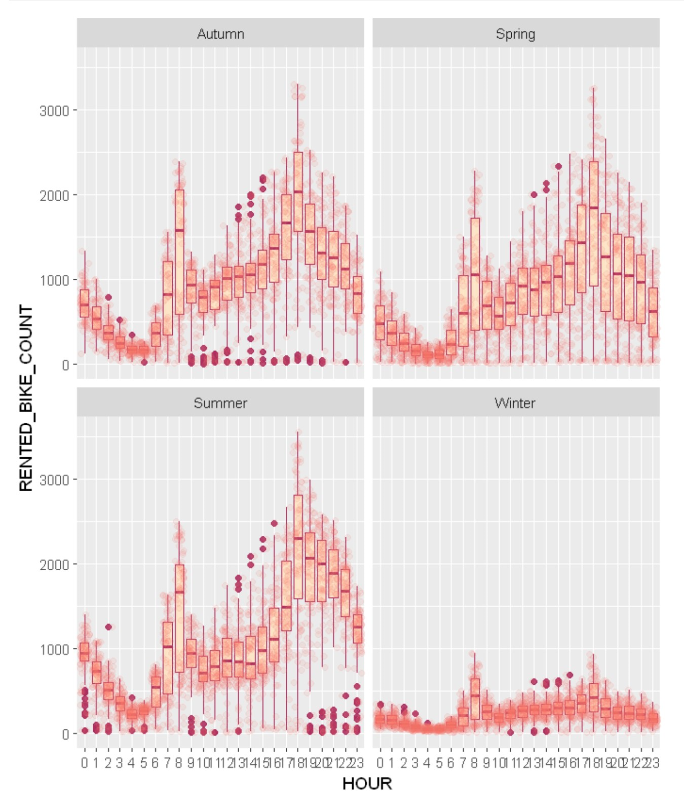
Bike Rental per hour by Season
Boxplot of rentals per hour by season
Usage peaks at 0800h and 1800h, possibly associated with commuting to and from work.
Usage reduces significantly in winter.
Peak hours are the same across seasons.

Slide 29
Predictive analysis

Slide 30
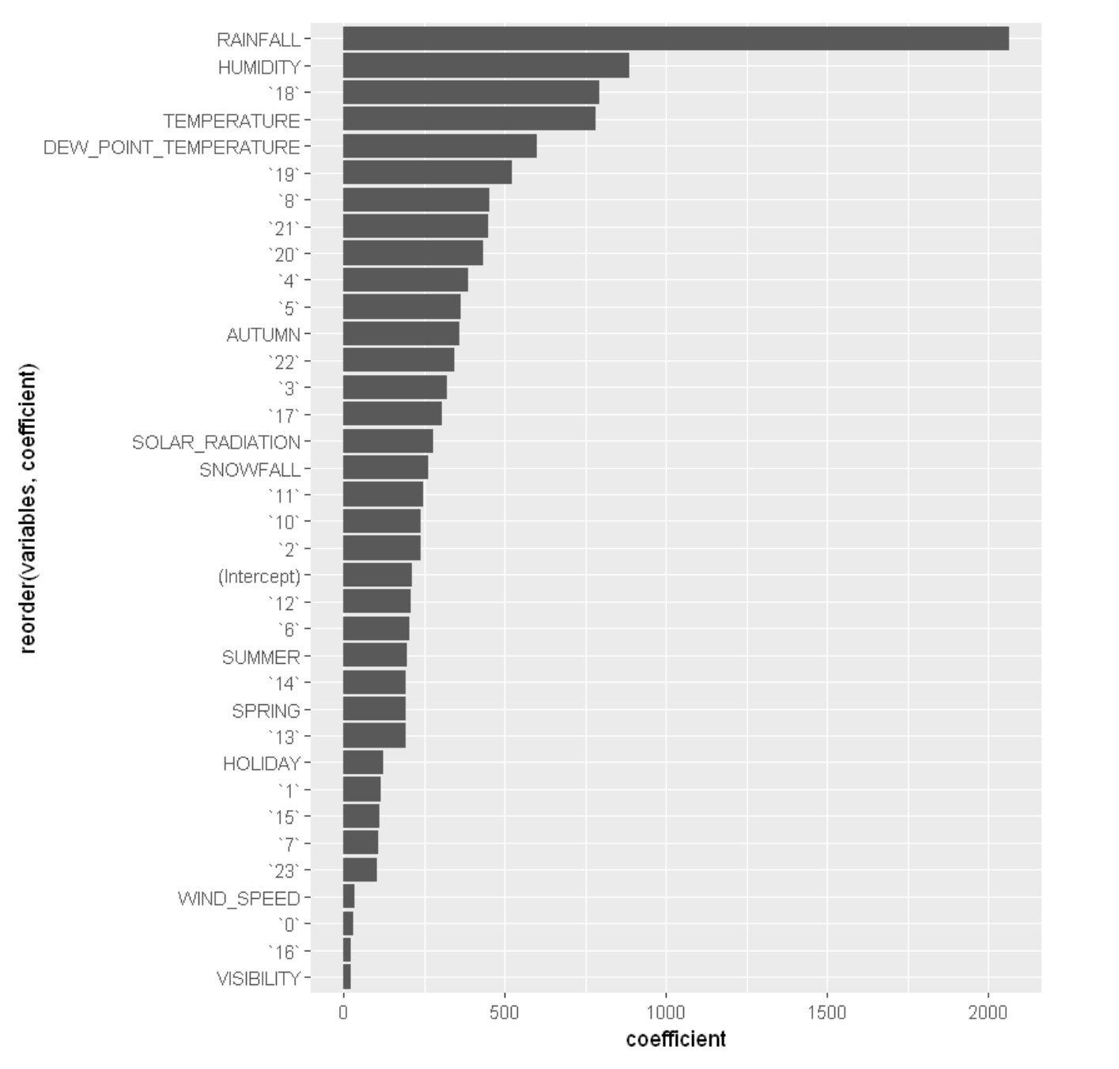
Ranked coefficients
The predictors with the most effect on bike rental demand appear to be rainfall, humidity and temperature.
Visibility and wind speed seem to have the least effect.
The hour of the day seems linked, but should be considered as a grouped variable instead of individually.

Slide 31
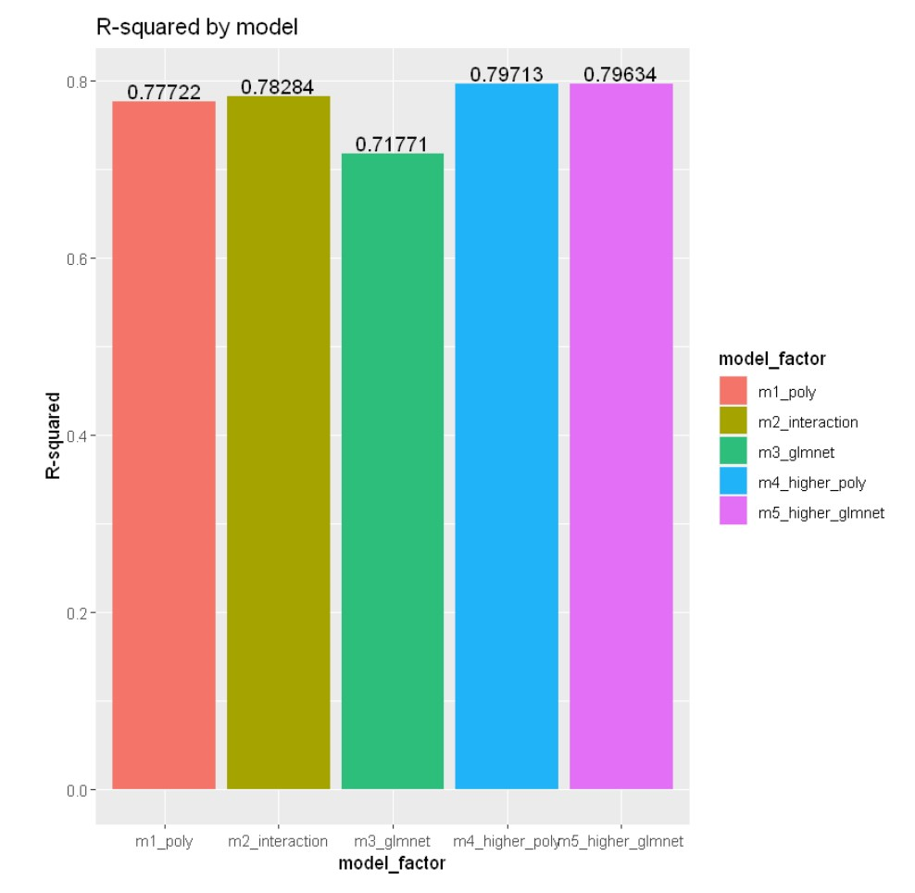
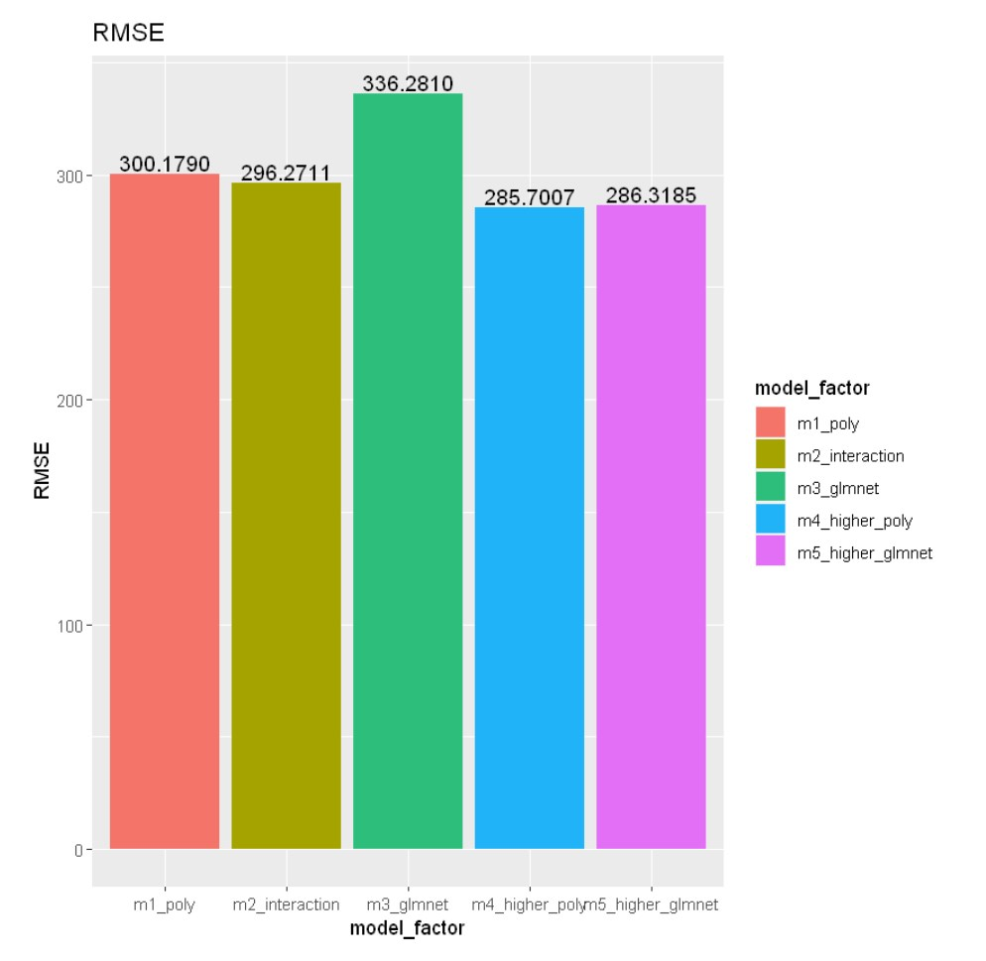
Model evaluation
Grouped bar charts of: polynomial regression, polynomial with interaction terms, glmnet regression, polynomial with added terms, glmnet with added terms.
The Polynomial Regression model with added terms has the highest R-squared (0.79713) and the lowest RMSE (285.7007)

Slide 32
Find the best performing model
Model Formula
(RENTED_BIKE_COUNT ~ `18`*TEMPERATURE*DEW_POINT_TEMPERATURE + RAINFALL*HUMIDITY*`4` + SOLAR_RADIATION*SNOWFALL + WIND_SPEED*VISIBILITY +`18`*TEMPERATURE+RAINFALL*HUMIDITY*`18` + poly(TEMPERATURE, 6) + poly(HUMIDITY, 6) + poly(WIND_SPEED, 2) + poly(VISIBILITY, 3) + poly(DEW_POINT_TEMPERATURE,6) + poly(SOLAR_RADIATION, 5) + poly(RAINFALL, 6) + poly(SNOWFALL, 2) + `18`+`4`+ `0` + `1` + `10` + `11` + `12` + `13` + `14` + `15` + `16` + `17` + `19` + `2` + `20` + `21` + `22` + `23` + `3` + `5` + `6` + `7` + `8`+ `9` + AUTUMN + SPRING + SUMMER + WINTER + HOLIDAY + NO_HOLIDAY + AUTUMN*SPRING*SUMMER*WINTER*HOLIDAY*`18`*`4`*`19`)

Slide 33
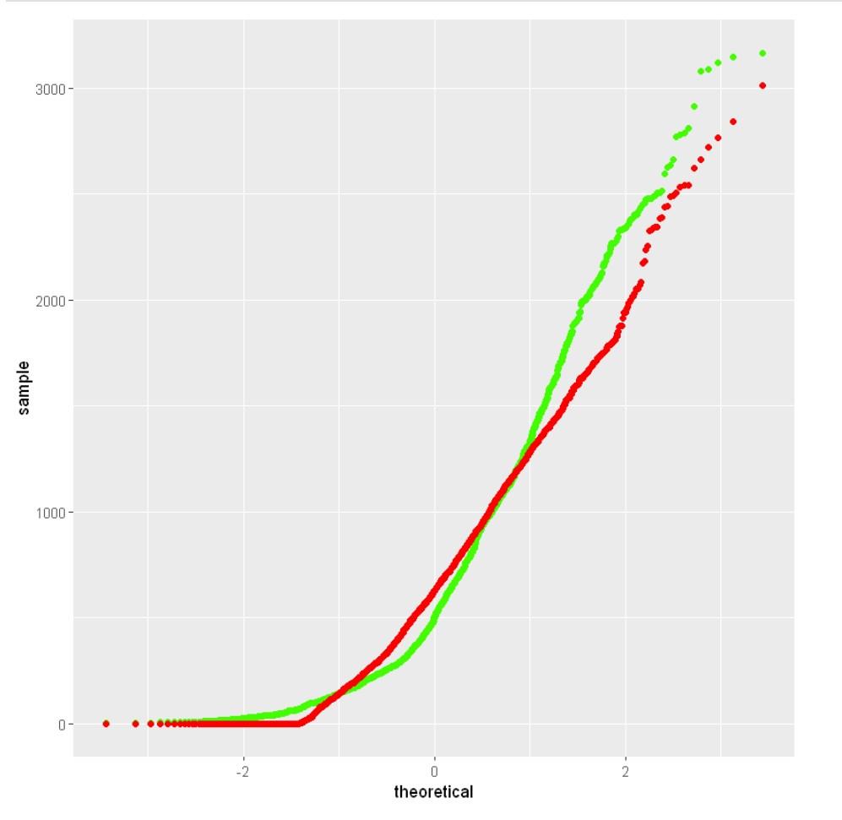
Q-Q plot of the best model

Slide 34
Dashboard

Slide 35
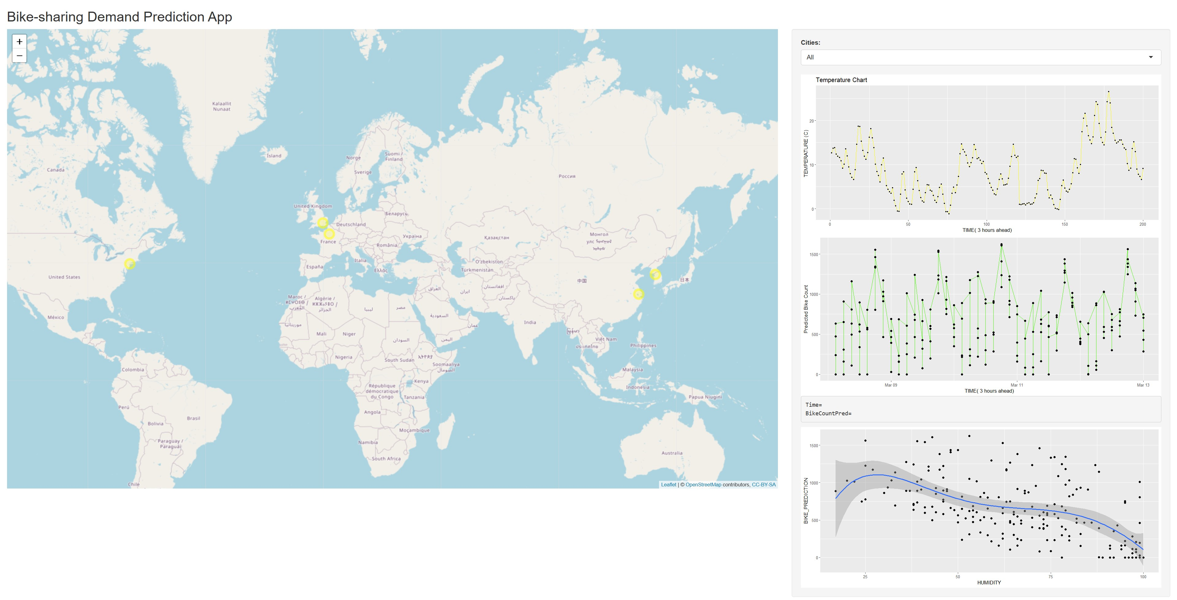
Worldwide Demand Prediction
Leaflet-based interactive worldwide demand prediction map
Dropdown to select a specific city (New York, USA, Paris, France, Suzhou, London)
Temperature chart
Predicted bike demand chart
Correlation between bike demand and humidity

Slide 36
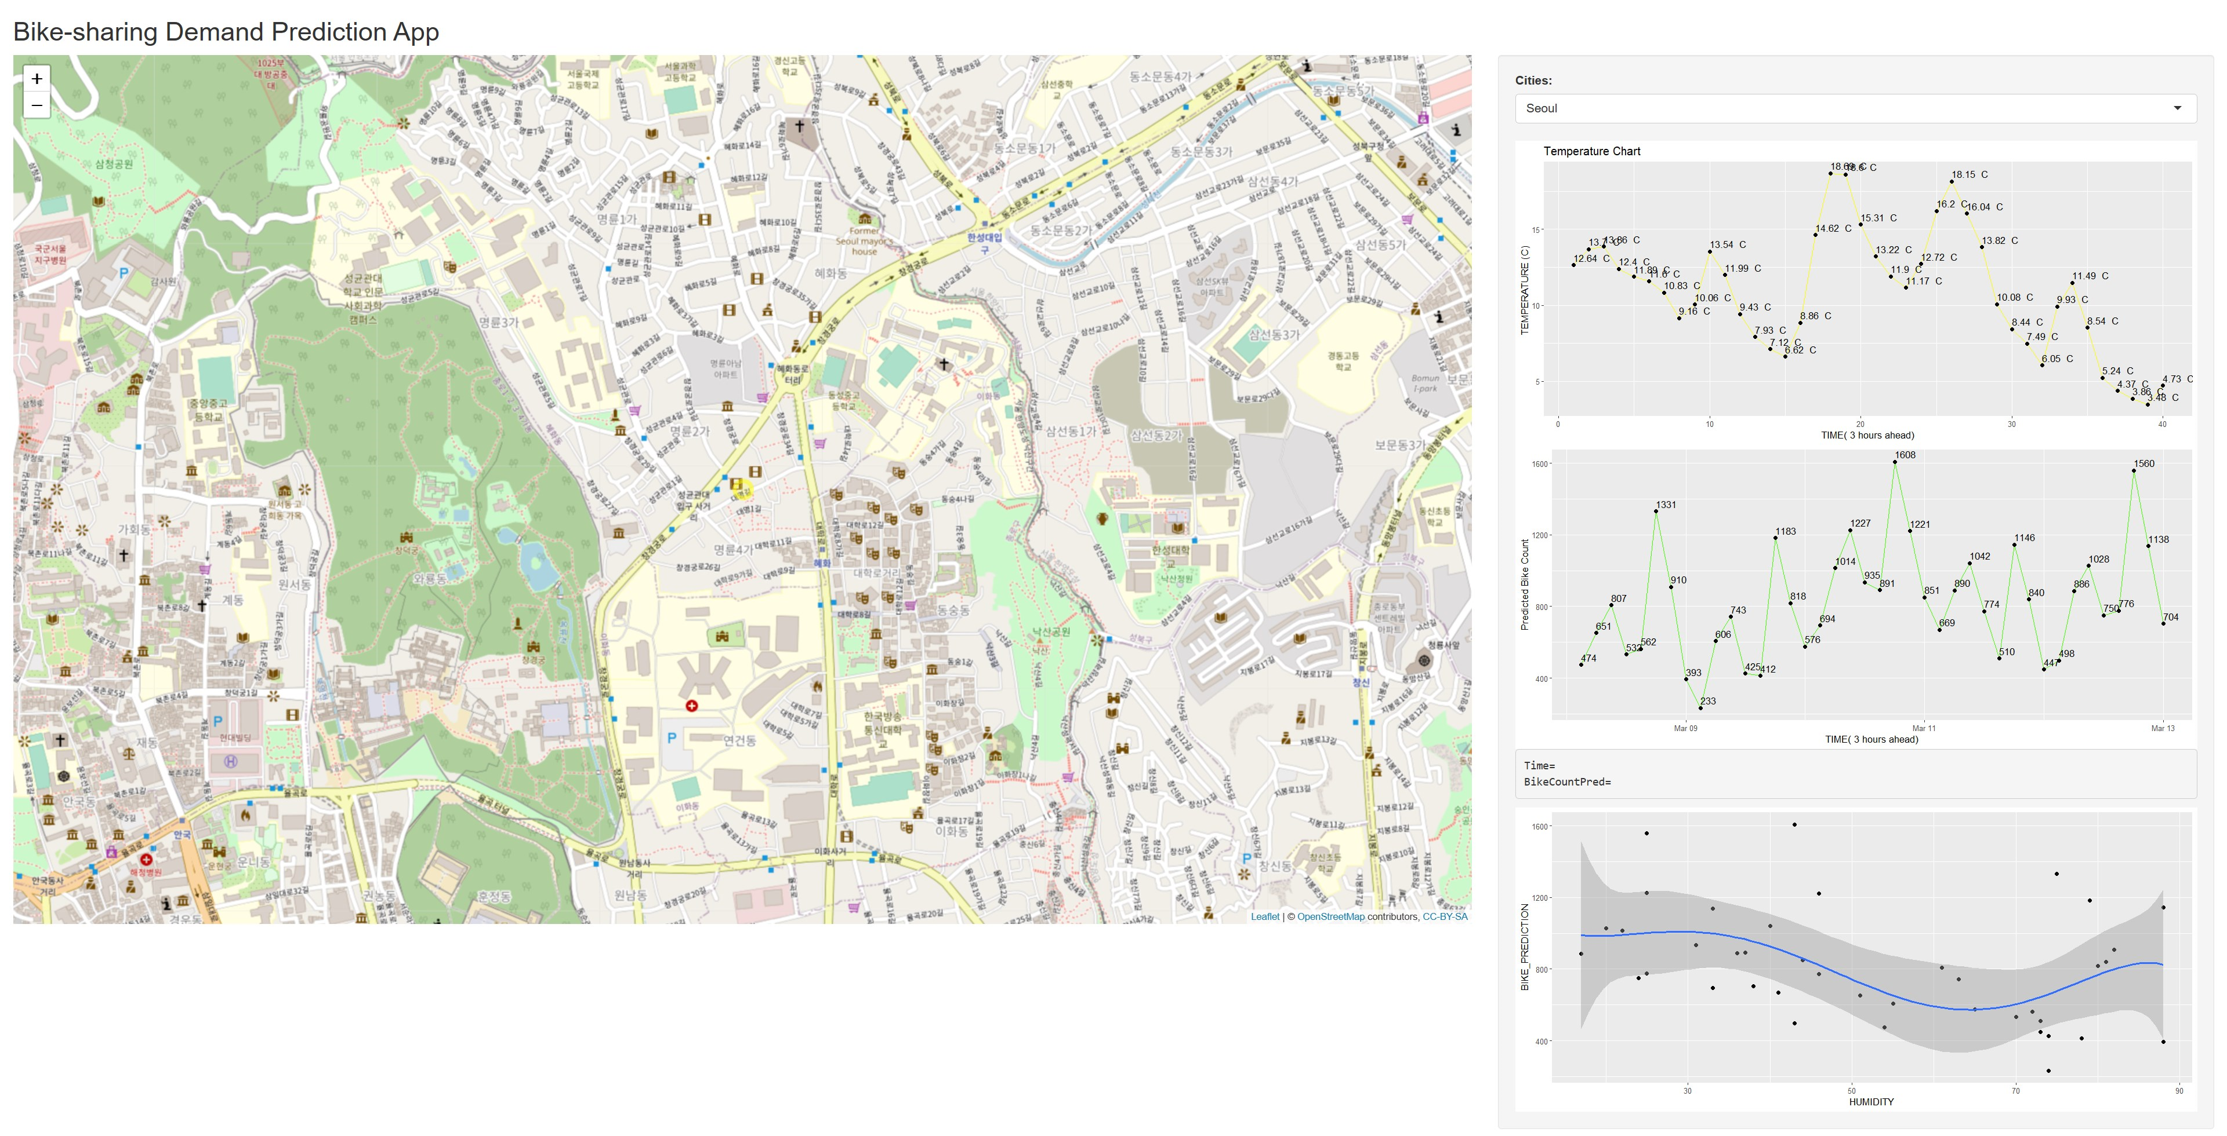
Bike Demand Map (Seoul)
Leaflet-based interactive city demand prediction map
Dropdown with Seoul selected
Temperature chart
Predicted bike demand chart
Correlation between bike demand and humidity

Slide 37
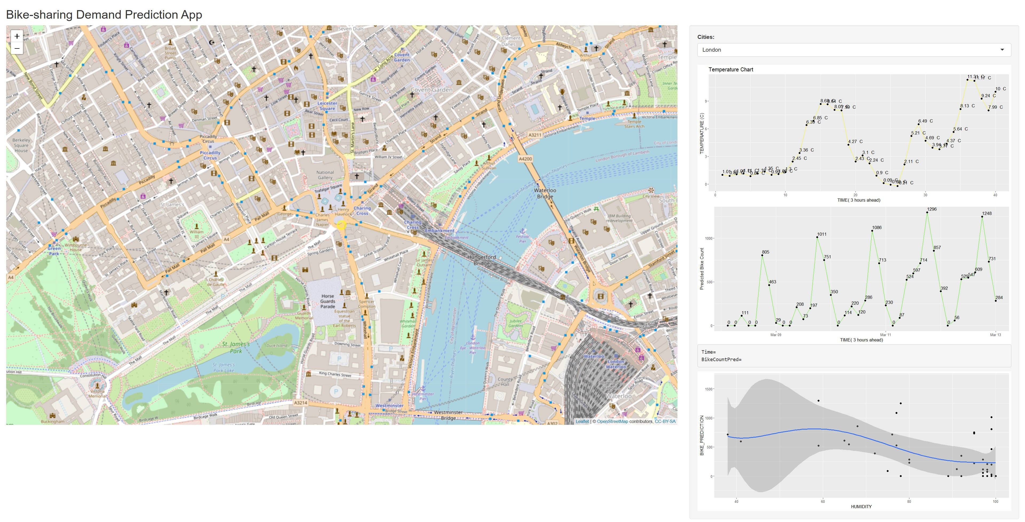
Bike Demand Map (London)
Leaflet-based interactive city demand prediction map
Dropdown with London selected
Temperature chart
Predicted bike demand chart
Correlation between bike demand and humidity

Slide 38

CONCLUSION
Bike sharing demand is highest in the summer.
Bimodal diurnal peak.
Affected by temperature, humidity, precipitation.
Regression models have predictive value for demand and logistics.

Slide 39
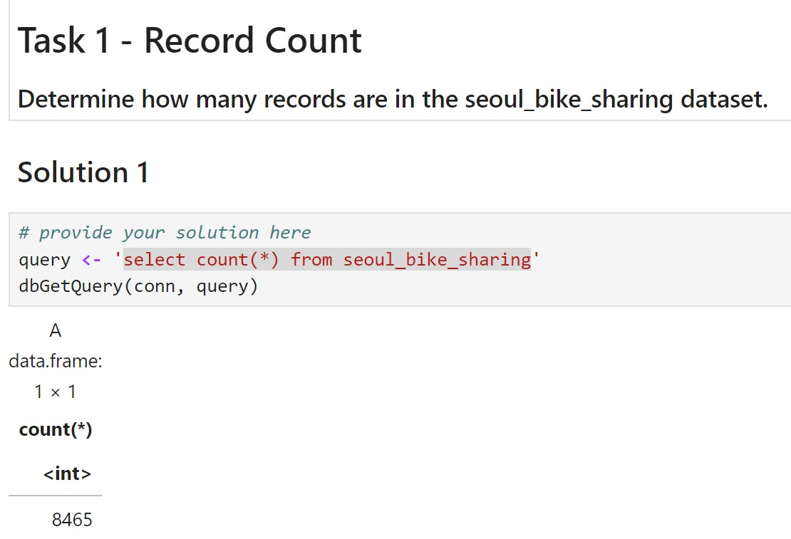
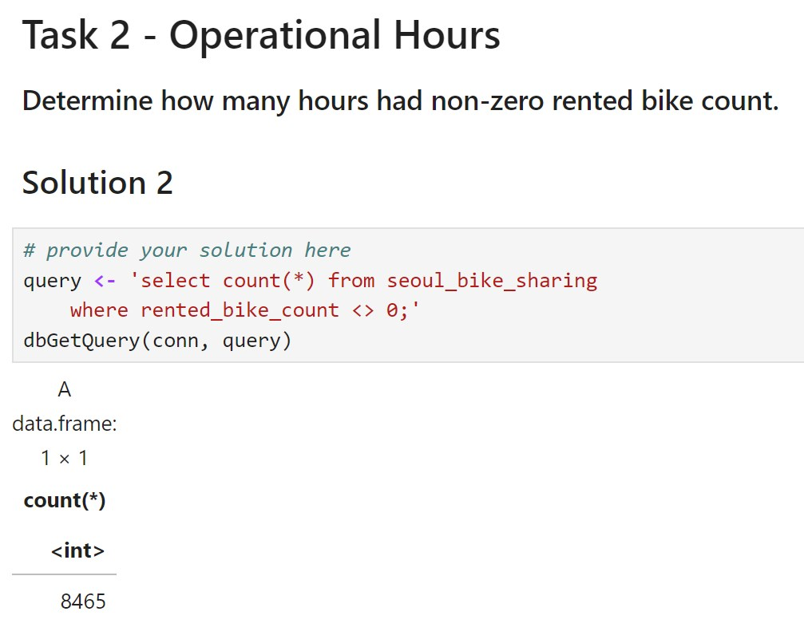
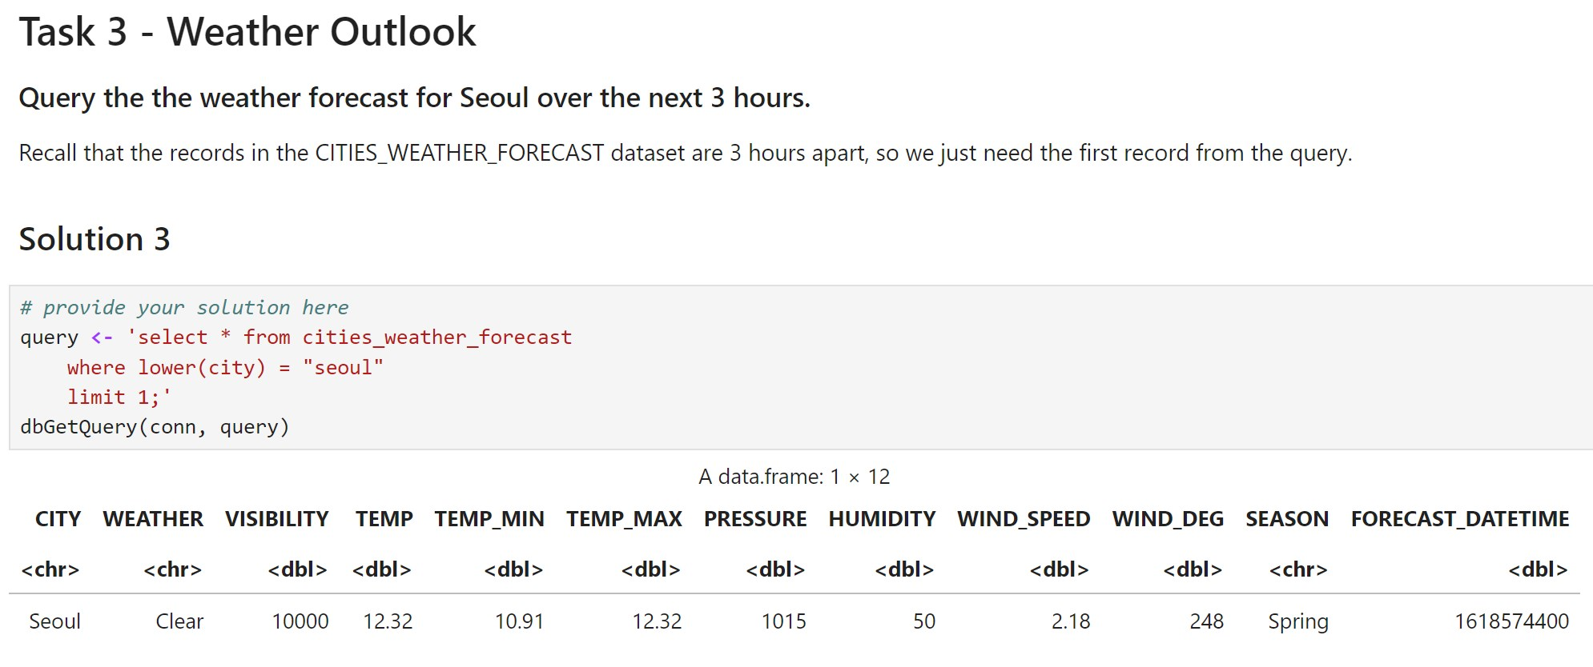
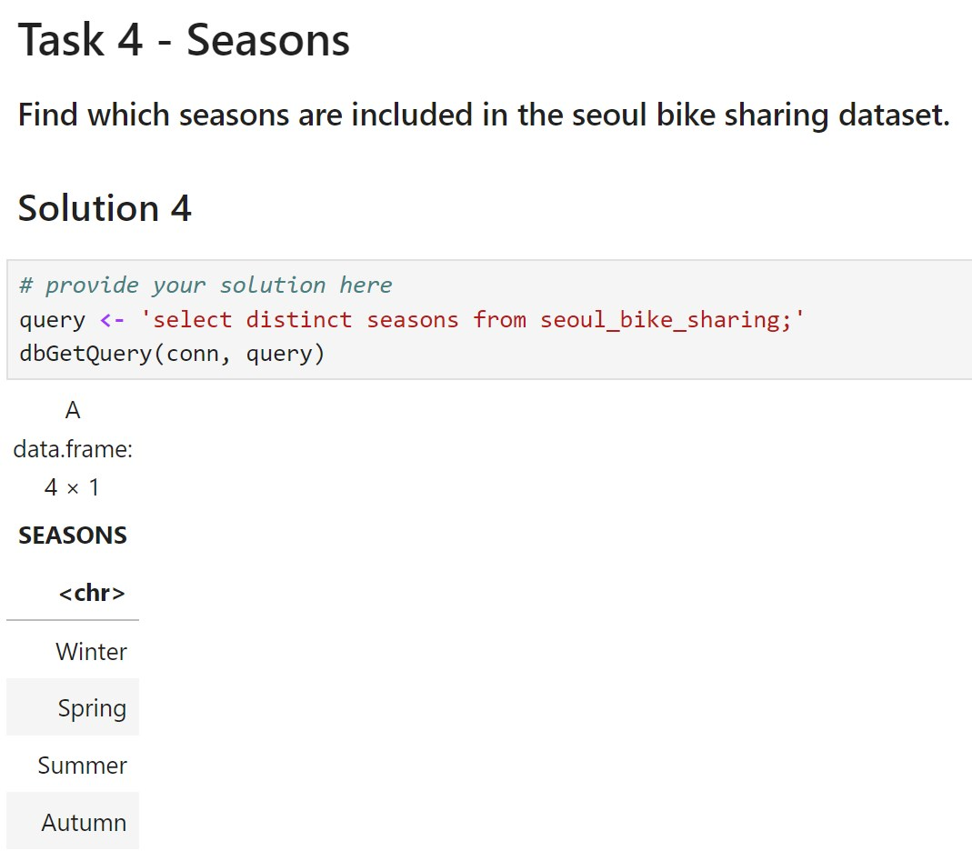
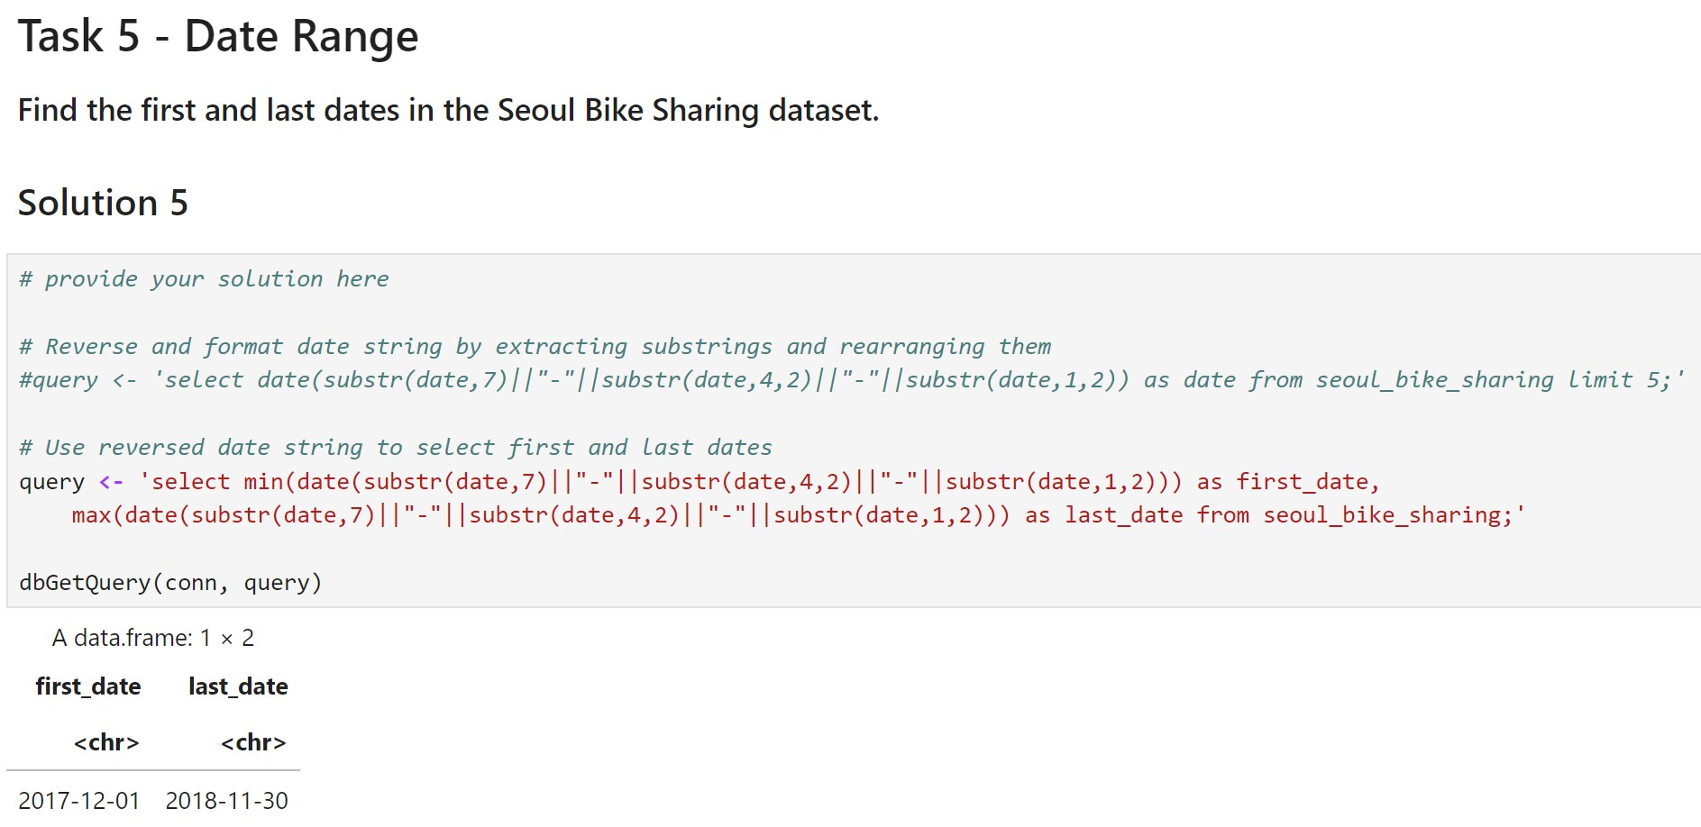
APPENDIX (Additional SQL Queries)

Slide 40
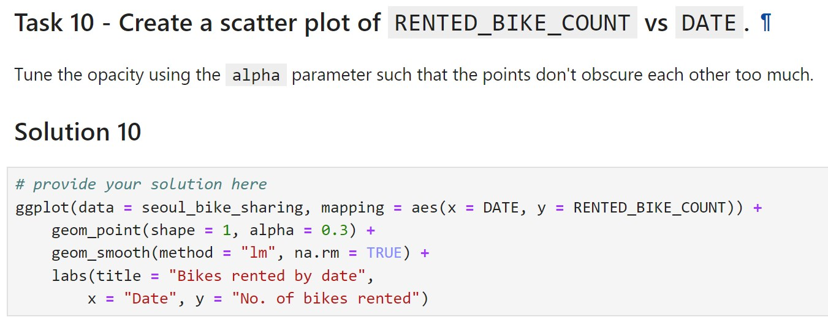
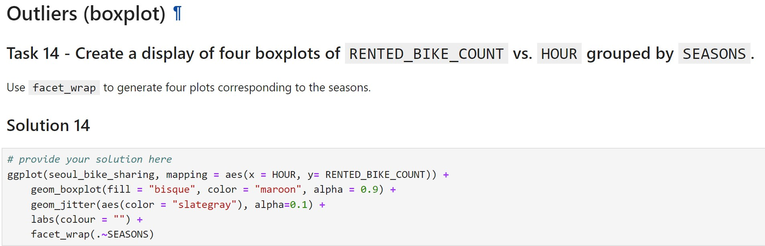
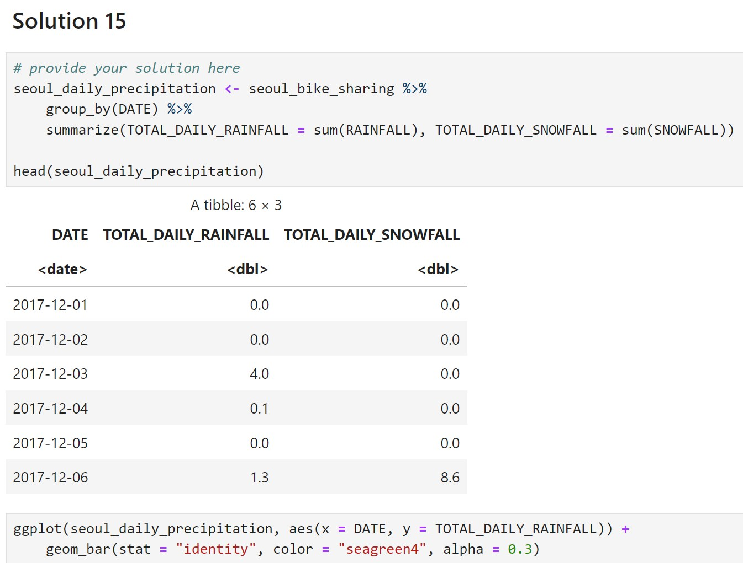
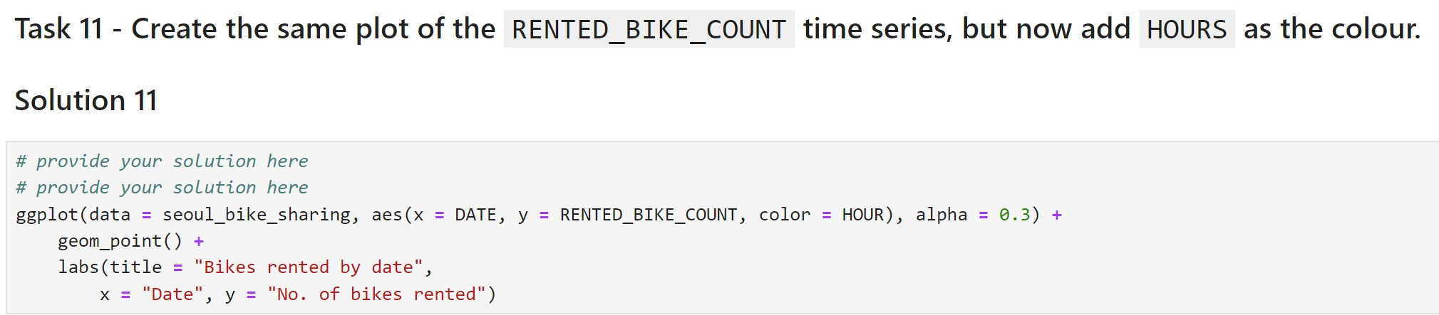
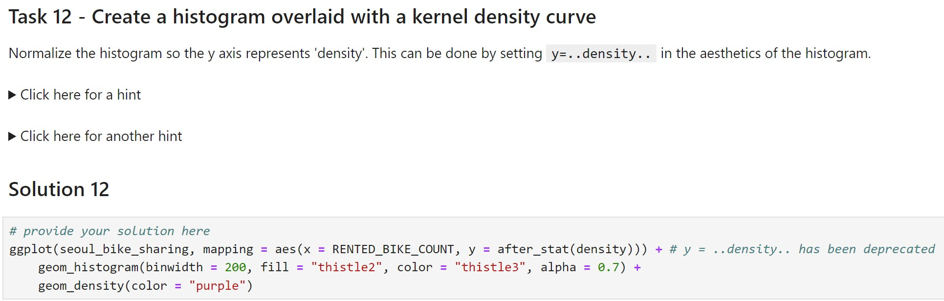
APPENDIX (VISUALISATION CODE)

Slide 41
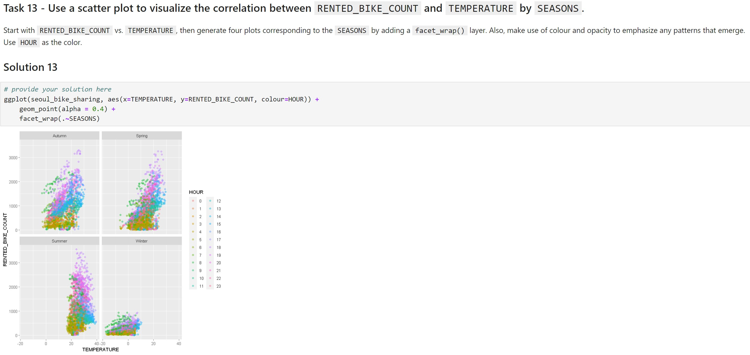
APPENDIX (VISUALISATION CODE)

